Slide 1
Team 3 Group Project
Notes:
Liam:
Introduction to why group 3 (3rd group made, university project, 1 year)
Introduces ourselves to SecOps:
Liam – Project leader/manager, cyber security specialist
Toby – Ai specialist
Khyati – Cyber security specialist & Primary UI/UX Designer

Slide 2

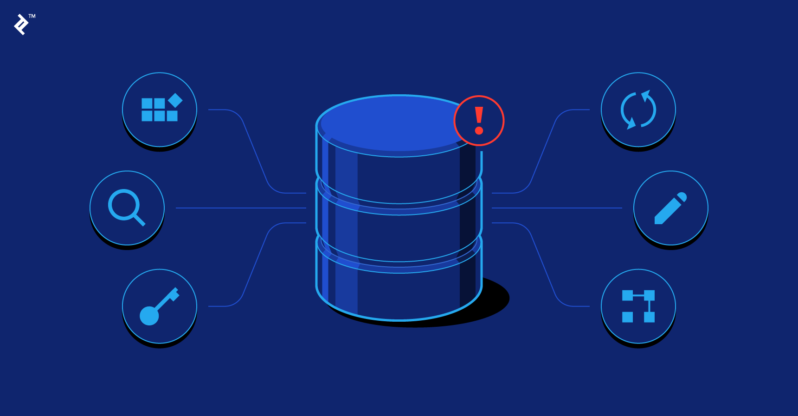
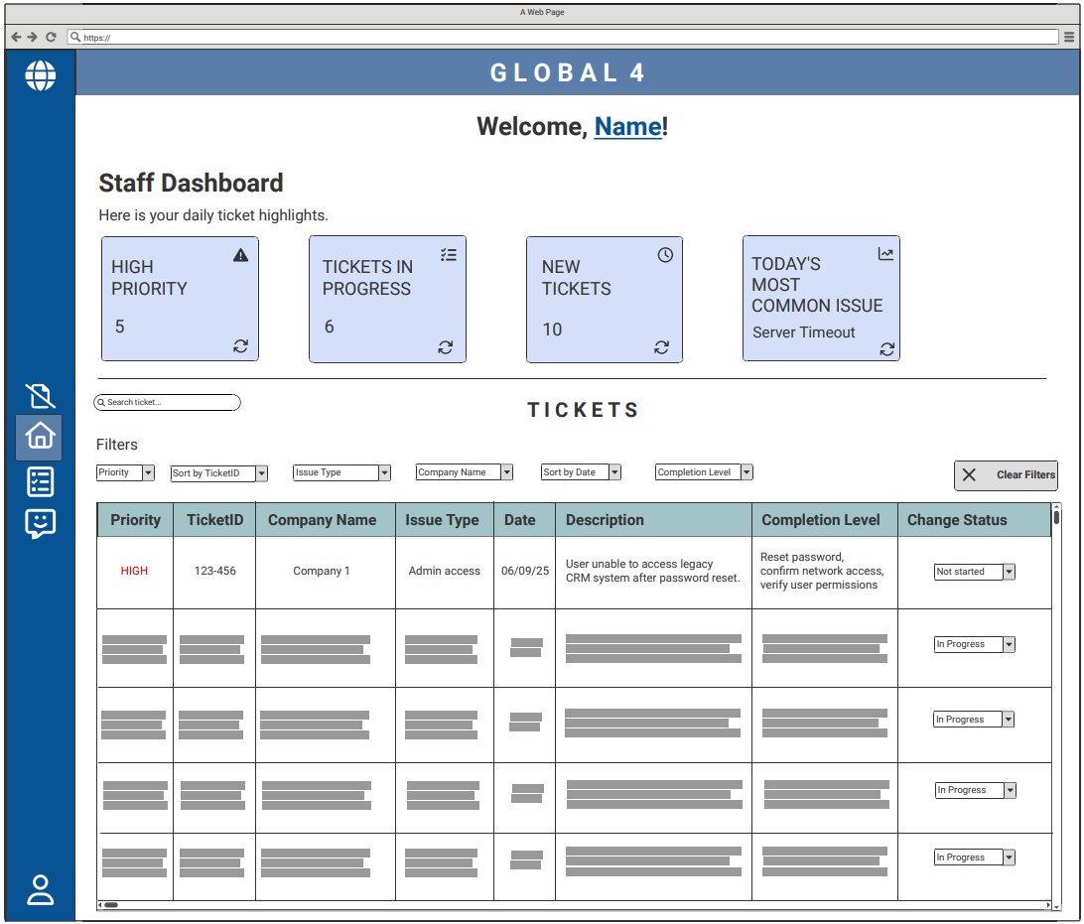

Project Recap
Stage 2 AI data organisation
Stage 1 retrieving ticket data from database
Stage 3 User Ticket viewing experience
Notes:
Briefly explain project recap
1 sentence summary - "automatic ticket organisation for security Operations department "
Simplifying/organising automatic tickets raised to the Secops department.
AI organiser to separate tickets and assign them to a category
simplistic and familiar UI to hide all complex operations and database management.
Our primary goal is to provide a user-friendly interface & automating the manual process.

Slide 3
Ticket Creation
Attributes:
Company Name
Device
Issue type
Sub issue type
Etc
SQL retrieve Data Commands
Notes:
We use the relational databases and the issue alert to create a ticket inside the new software. This ticket will now look to be processed by the AI

Slide 4

Ticket AI Organisation
Company with most Alerts:
TicketData1
TicketData2
TicketData3
Alerts:
TicketData1
TicketData2
TicketData3
TicketData4
TicketData5
Reads data in each ticket
Critical Alerts:
TicketData4
AI Alert Organiser
Backups:
TicketData5
Notes:
Ticket will be organised into different sections depending on priority/issue type/company/etc by an AI. This AI will be programmed to assist technicians by organising tickets in weighted system where the higher the weight of the ticket the more important the AI will consider the ticket. This means the AI will organise the categories and ticket queue as such.

Slide 5
Ui Software Layout Low Fidelity Design
Notes:
Khyati:
Explaining each UI design briefly. Try not to state the obvious as we are restricted by time in these meetings.
Short Example for a singular UI Screen "on the top half of this screen we have the organised sections (we will create categories upon feedback from SecOps) and below that we have a general space to mimick the aestethic of Autotask for alerts now if I click on this side button it will take us to …. [next scren]"

Slide 7
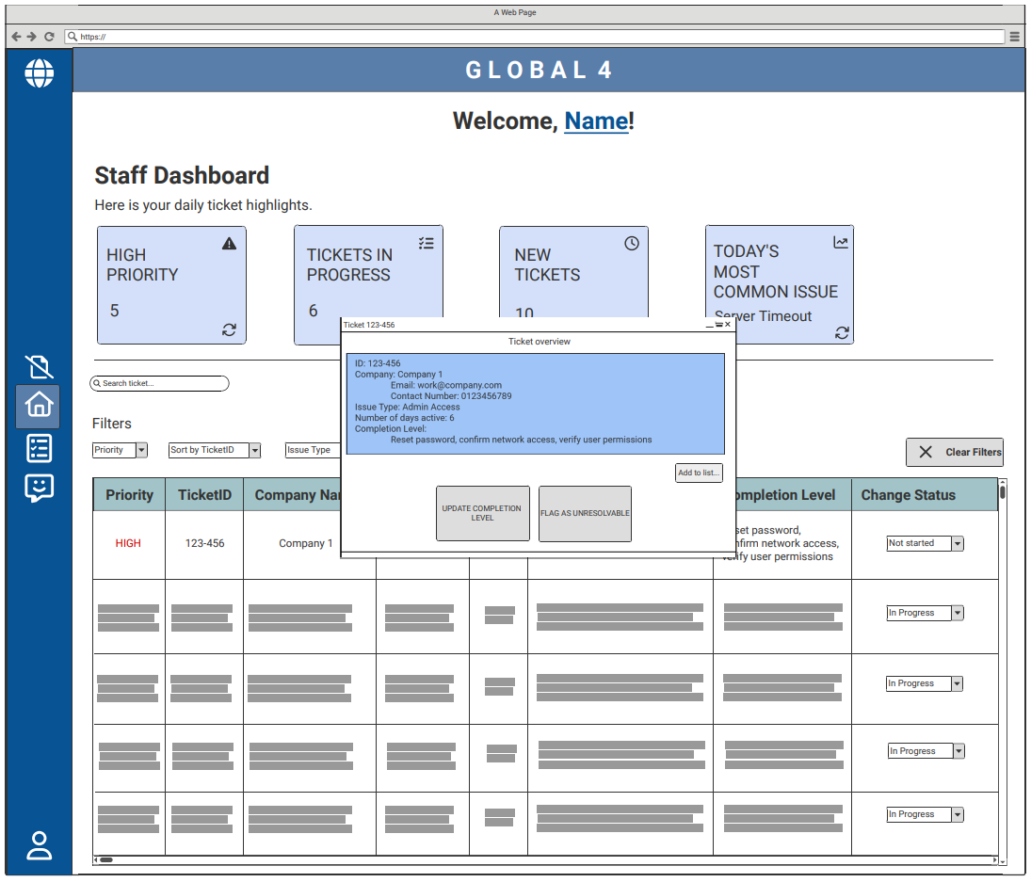

Slide 8
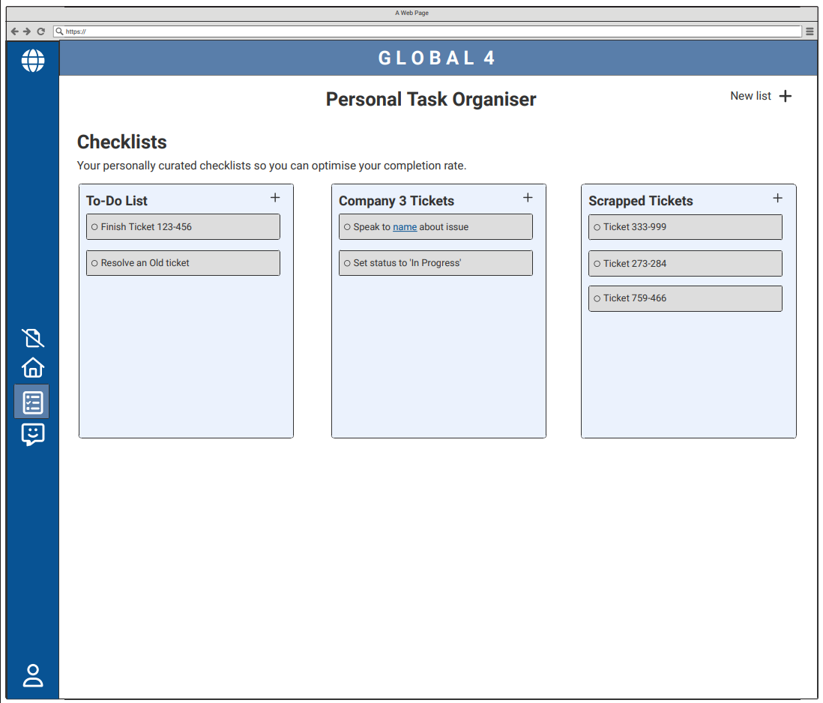

Slide 9
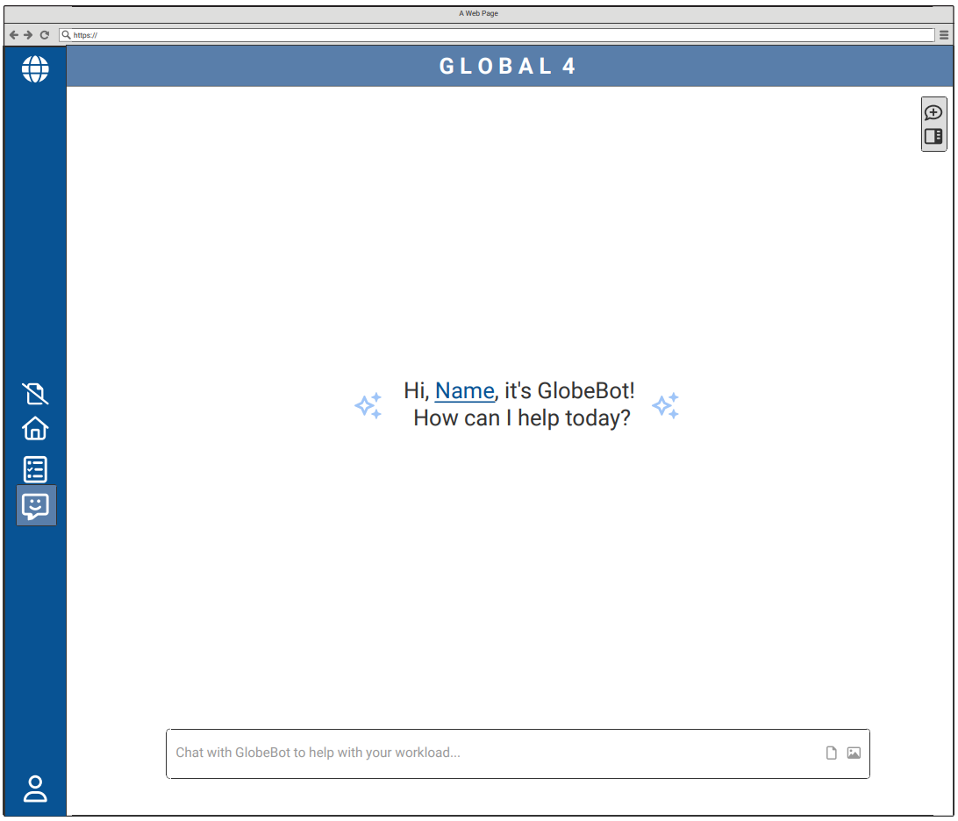

Slide 10
